Slide 1
Security systems
Safety systems
PSIM Software
Special systems
Smart home
Fleet monitoring
Our systems and services

Slide 2
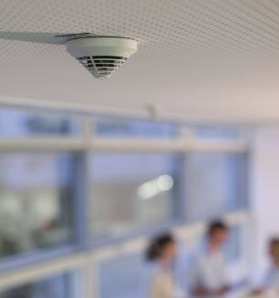
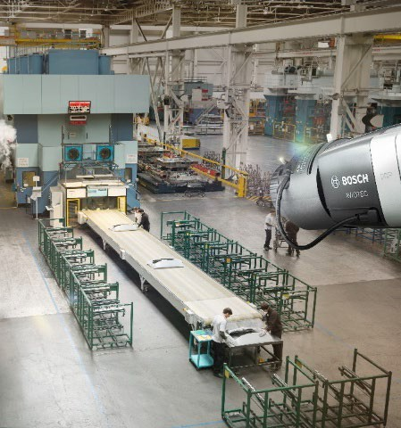
Fire Alarm Systems
Reliable in every respect
 Accurate fire detection
 Future-proof solutions
 Long-term partnership
Innovative and technology-driven
 Video-based fire detection solutions
 Remote control, maintenance and service
 Powerful planning tools
Our comprehensive portfolio includes fire panels, detectors, call points, video-based
fire detection and other accessories
Flexible to the max
 Tailor-made and modular solutions
 Independent from verticals, applications or project

Slide 3
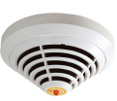
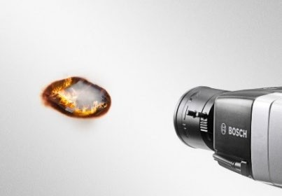
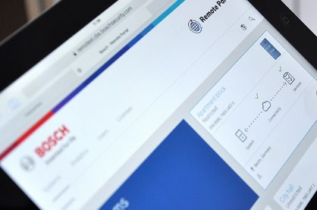
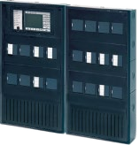
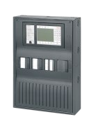
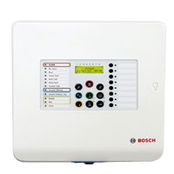
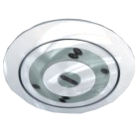
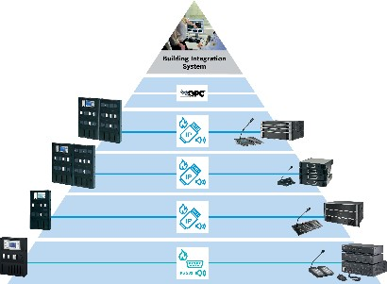
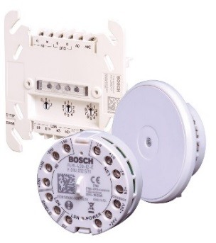
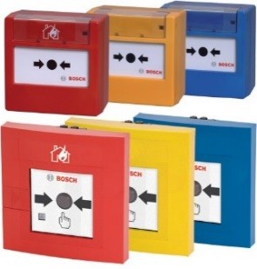
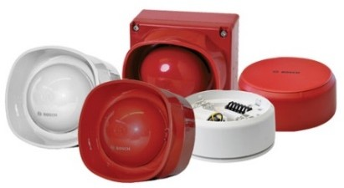
Fire Alarm Systems Product Overview
 Fire Panels – Modular, flexible and adaptable to personal requirements
 AVENAR detector 4000 – Multi- criteria fire sensors, Intelligent Signal Processing, eSmog feature
 Detector 500 Series- Smooth surface, color adaptation, multi- sensor detection
 Video-based Fire Detection – Fast detection and proven superior robustness against false alarms
 Remote Services – Secure and quick maintenance of fire systems via Internet
 Voice Alarm Systems– Best in class addressable alarms with battery backup
Complete Panel Portfolio | State-of-the-Art Detectors | Video-based Fire Detection | Remote Services
Voice Alarm Systems | Sounders and Strobes | Interface Modules | Manual Call Points
7

Slide 4
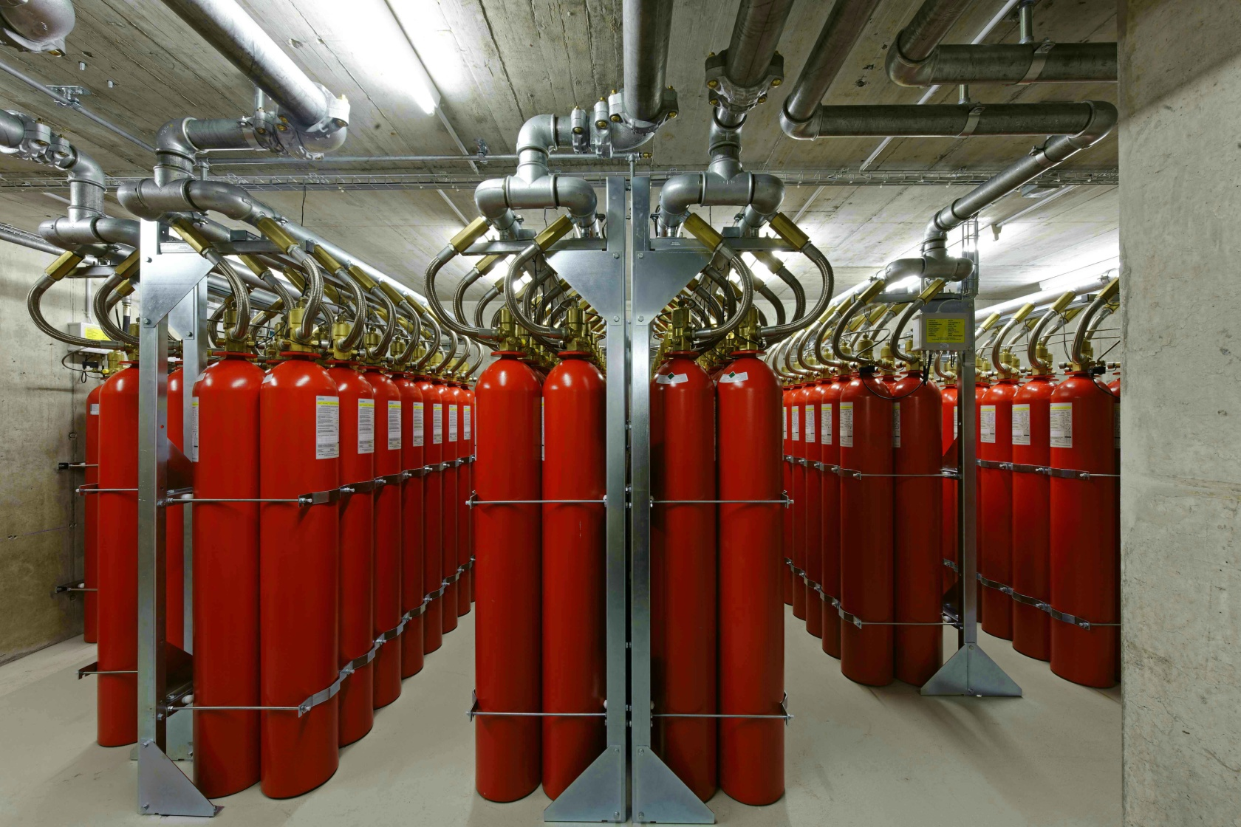
Fire Extinguishing MX 1230 Fire Extinguishing Systems Fighting Fire using Novec™ 1230 from 3M™

Slide 5
Fire Extinguishing Sprinkler Systems
Wet pipe system
The wet pipe system is the most common type of sprinkler system. In this type of system, the sprinkler pipe network is completely filled with pressurized water.
Dry pipe system
The dry pipe system is designed especially for areas subject to the danger of frost.
The sprinkler pipe network is not filled with water in the critical areas, but rather with compressed air, past the dry alarm valve.

Slide 6
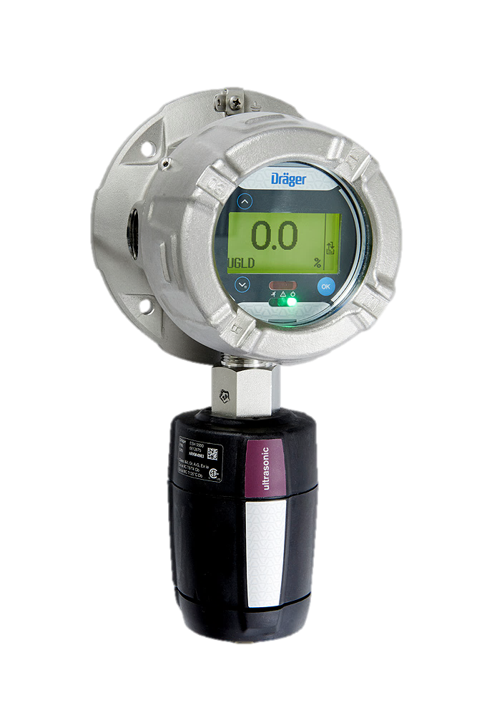
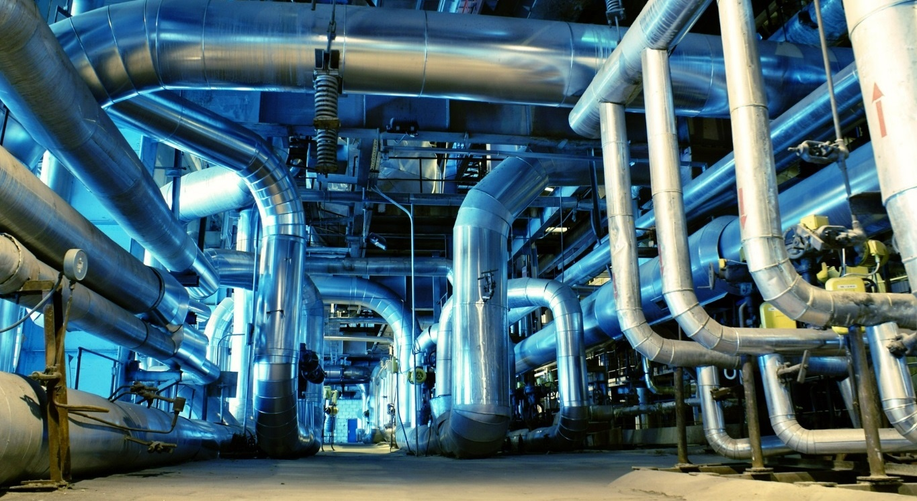
GAS detection
Production plants often involve complex, space-optimised constructions. This poses challenges for the installation as well as the maintenance of a gas detection system.

Slide 7
Public Address system
Expertise and outstanding quality: Forecasting challenging situations and user needs; vast experience and expertise; highest technology performance.
Intelligent solutions: Technologies that create a fascinating experience; use of existing infrastructures; remote diagnostics and maintenance; IP-based systems and software-controlled devices.
Bosch develops systems that deliver the highest performance in speech and music quality. Our goal is to address changing customer needs with outstanding systems that cater for applications of every size.
Wide and resilient public address and speaker portfolio: Contributing to a better world; catering for applications of every size; accommodating changes to building use.
Global partnerships and closeness to customers: Supporting our customers to shape their future.

Slide 8
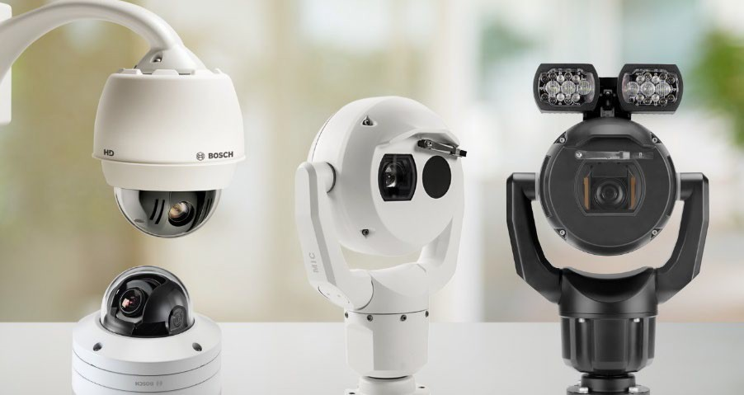
Video Systems
Video Analytics at the edge as standard
Analyze video data to improve security and gain clear business advantages.
Outstanding performance
 High quality imaging technologies like starlight to easily distinguish individuals or objects, even at extreme low light levels
 Reduce bitrate up to 80% and save storage costs without compromising video quality
A broad portfolio of fixed and moving cameras.
Highest levels of data security and privacy protection
Integrated hardware and software measures to keep video data secure, such as a crypto co-processor and a built in trusted platform module.
All video systems product are easy to install, manage and use.

Slide 9
Access Control Systems
Protect secure areas from unauthorized access or unlock doors in emergencies.
Flexible and scalable – thanks to the scalability of the components, the system grows according to your security needs.
Our portfolio includes all access control components from different software options
and controllers to a wide range of readers and
credentials.
Reliable – with state-of-the art security features and encryption.

Slide 10
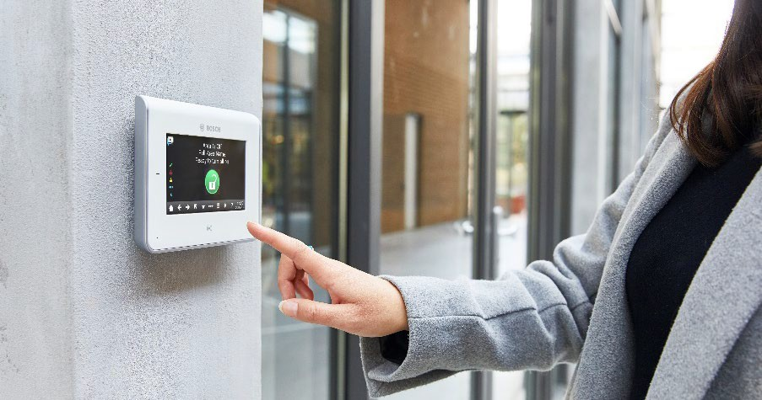
Intrusion Alarm Systems
Intrusion Alarm Systems built for customization
 Seamlessly work with Bosch IP video cameras, video management, and access control.
 A range of control panels, communicators, detectors, and accessories to provide the right solution from stand-alone retail stores to office buildings, warehouses, banks, and more.
Our portfolio includes all access control components from different software options
and controllers to a wide range of readers and
credentials.
High quality motion detectors
 Deliver excellent catch performance while providing the highest level of false alarm immunity
 Easy to install and built to last

Slide 11
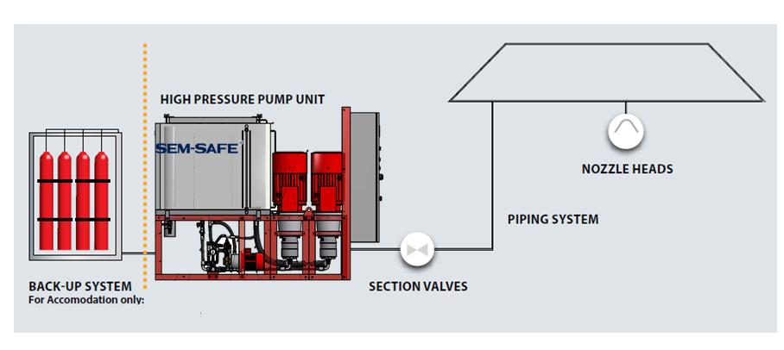
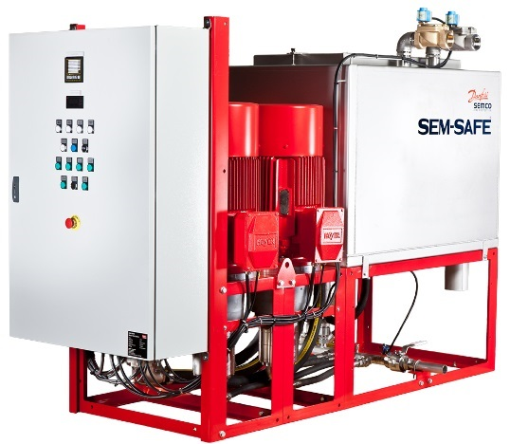
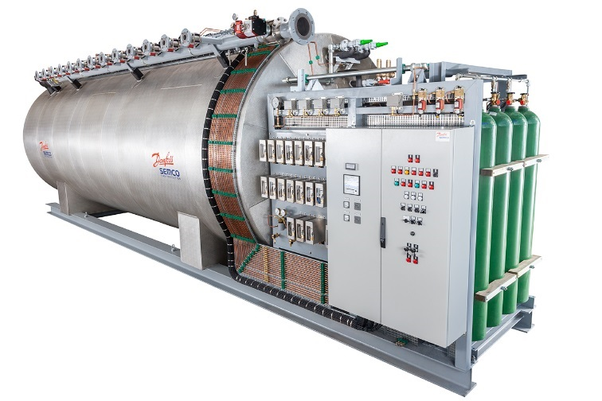
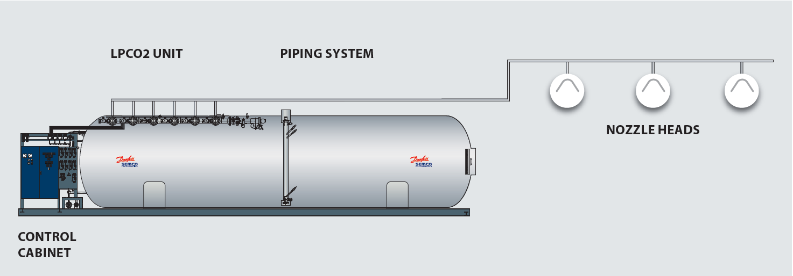
Special Systems
SEM-SAFE® high-pressure water mist
Low-pressure CO₂

Slide 12
Capabilities of a Management System
Safety & Security Fire, Intrusion, Video, Access, etc.
Evaluation Analysis & Reports
Guided Workflows
Geographic Information Systems
Solution Partner Incident Management/ Ticketing Systems, etc.
Building BA & HVAC
CAD Floor Plans
Open Interfaces
Communication Information & Communication Technology
Mobile Access
Technicians, Guard Services, etc.

Slide 13
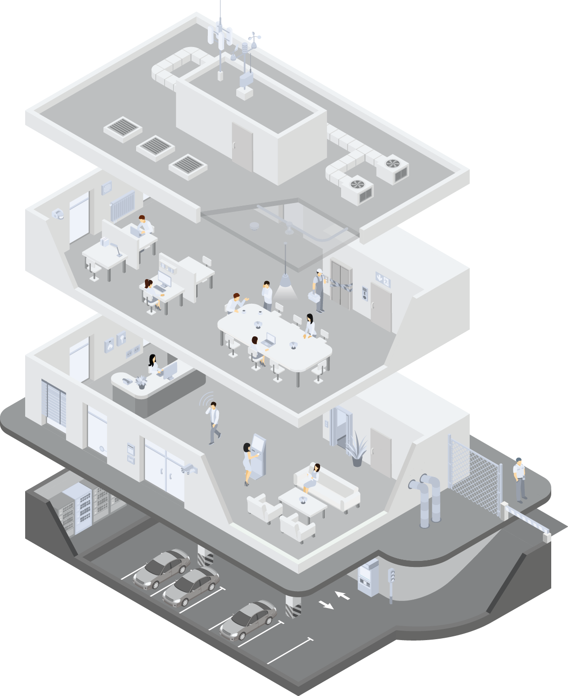
Integration Possibilities
Safety & Security
Fire Alarm
Extinguishing System
Intrusion Detection
Public Address
Escape Route Control
Emergency Lighting
CCTV
Access Control
Perimeter Surveillance
Key Management
…

Slide 14
Integration Possibilities
Building
Building Automation
HVAC
Lighting Control
Parking Management
Emergency Power Supply
…

Slide 15
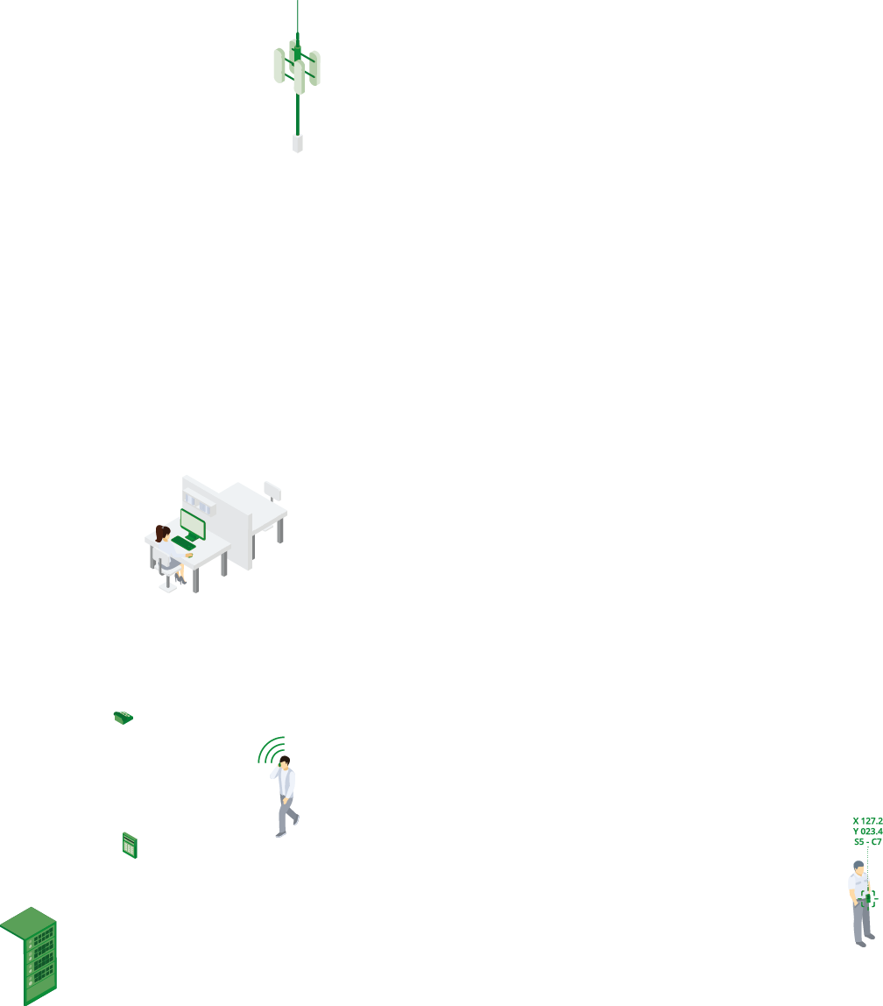
Integration Possibilities
Communication
Telephone System
Intercom
E-Mail, SMS, Pager
IT Infrastructure
Mobile Devices
…

Slide 16
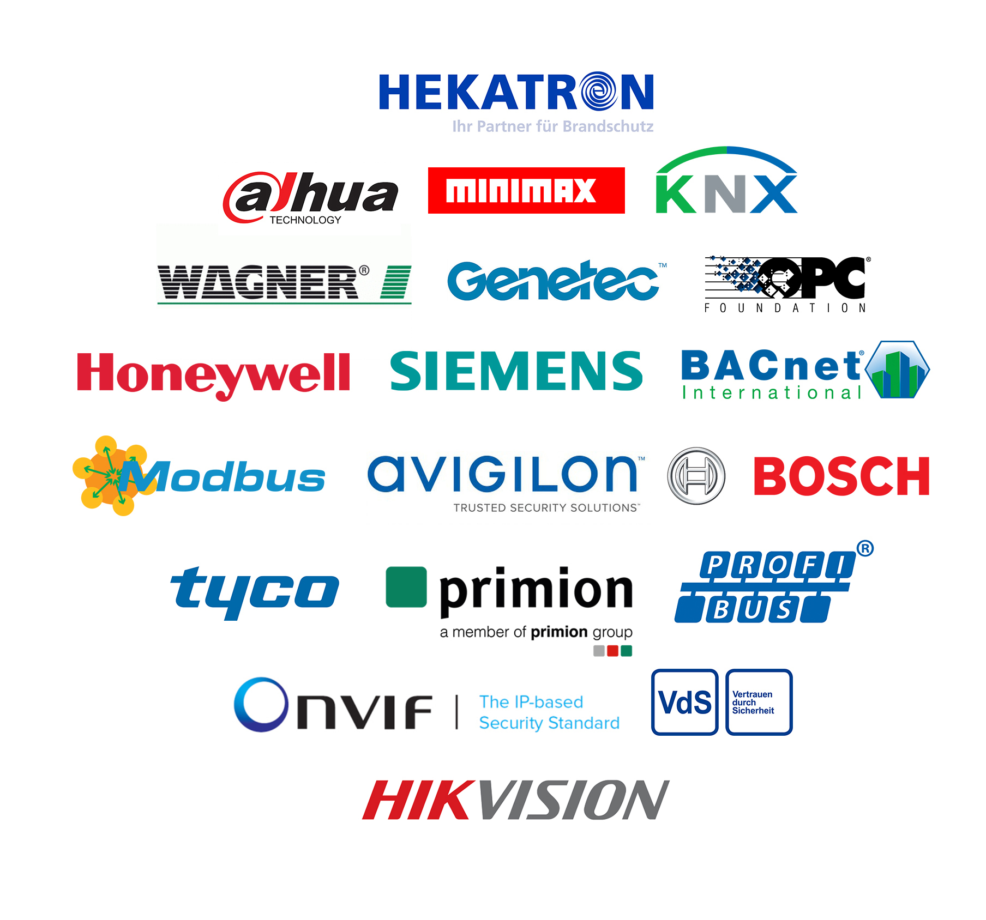
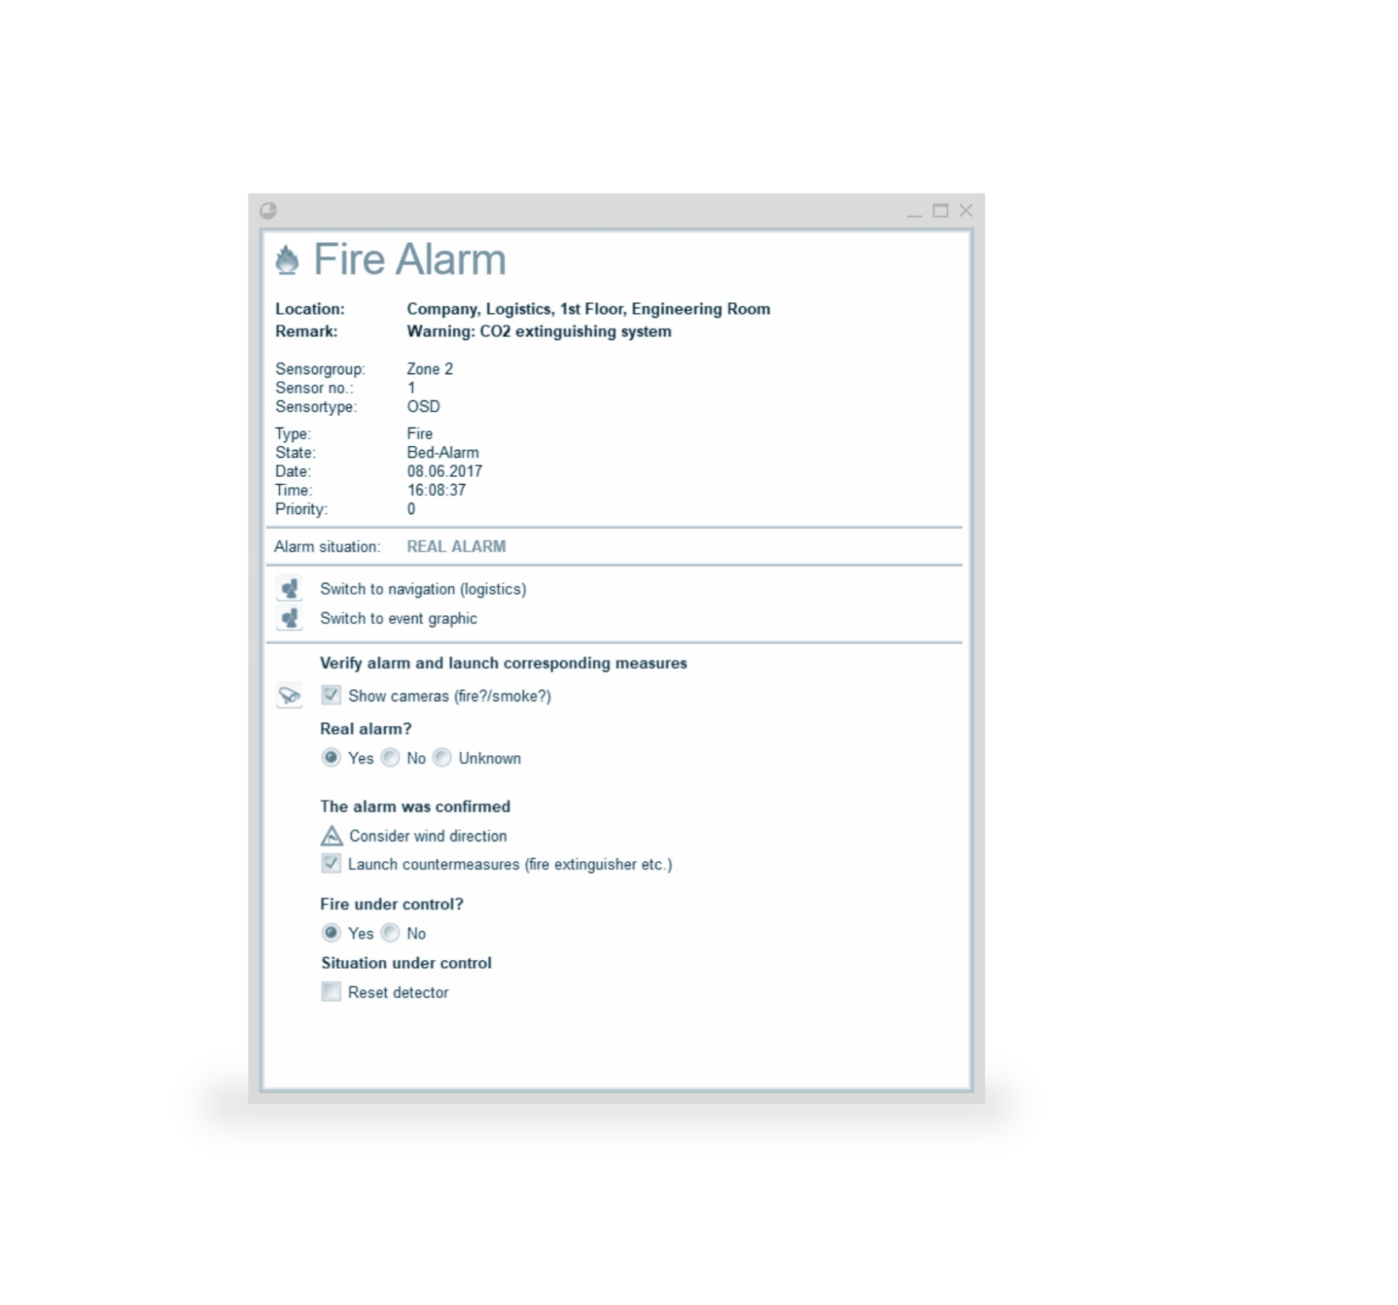
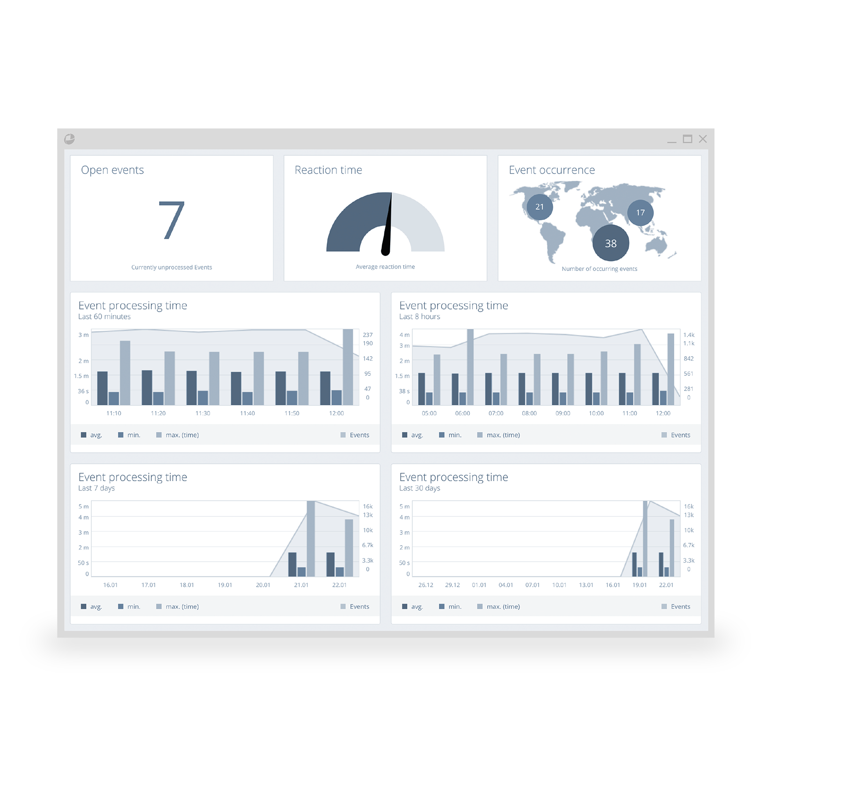
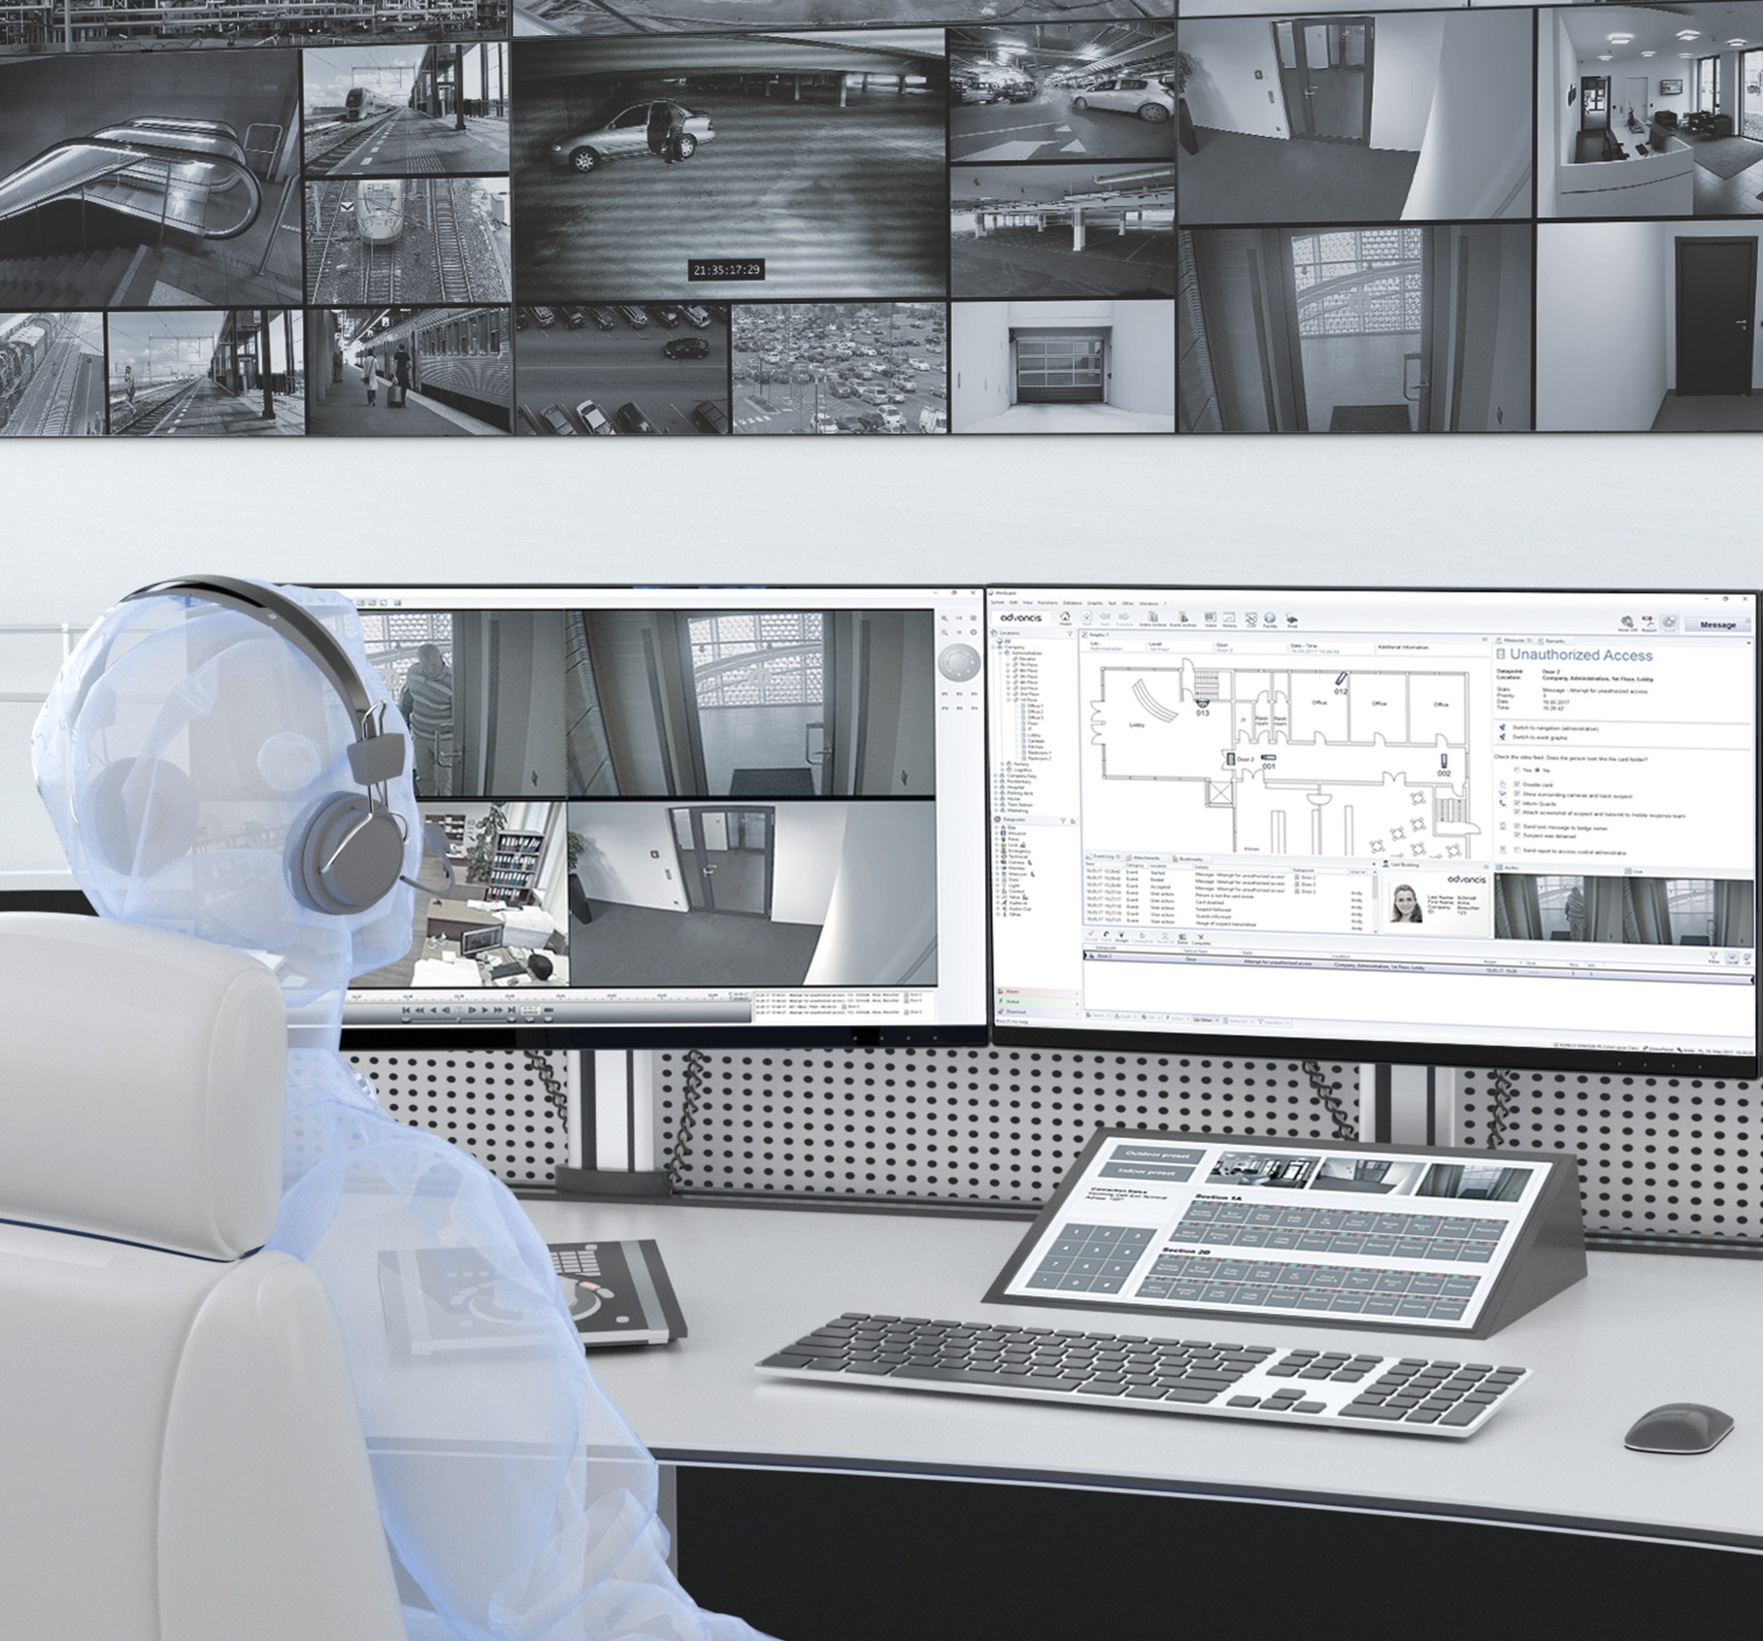
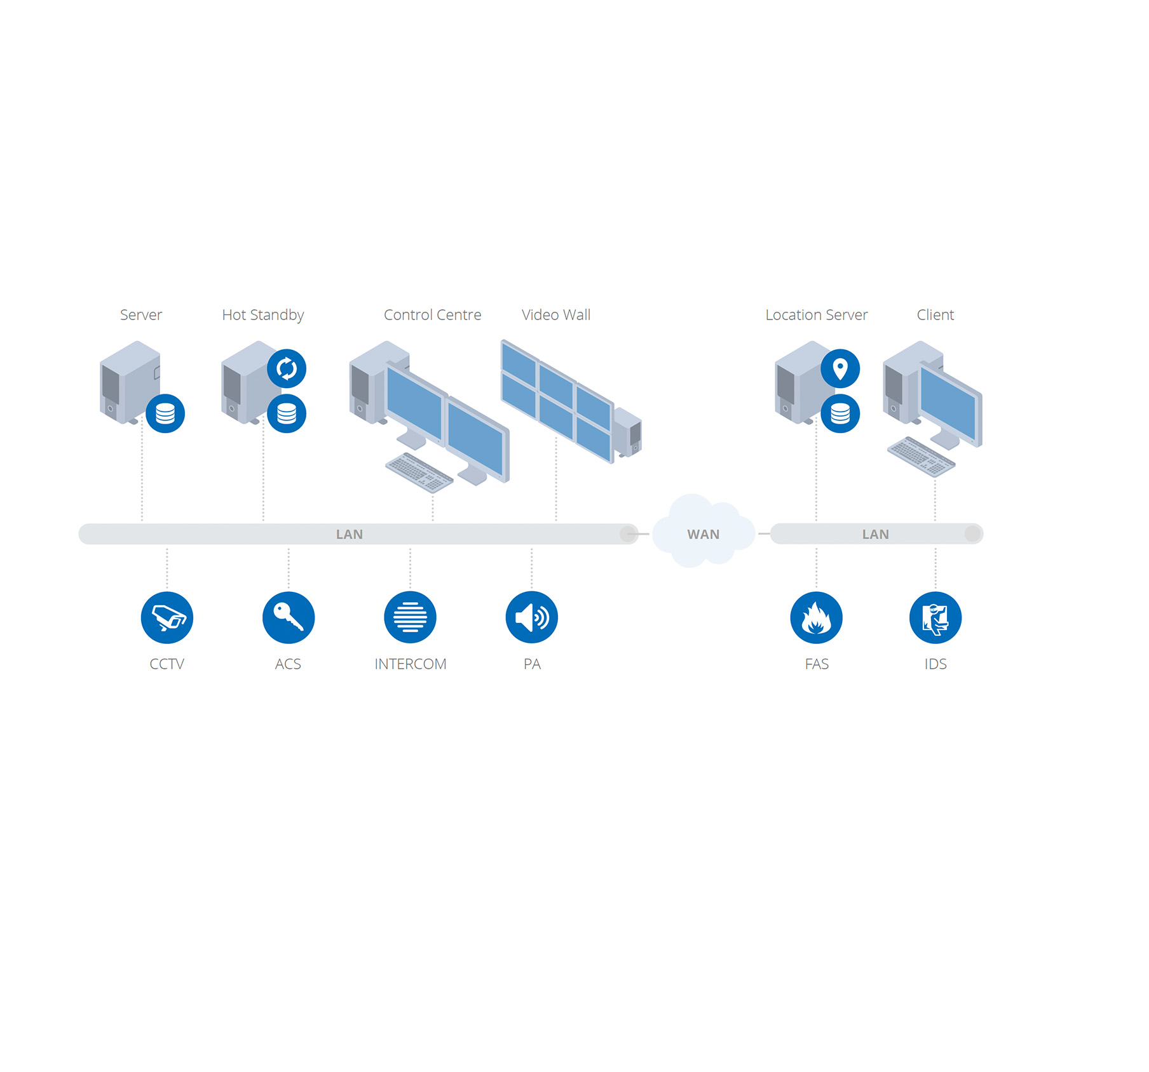
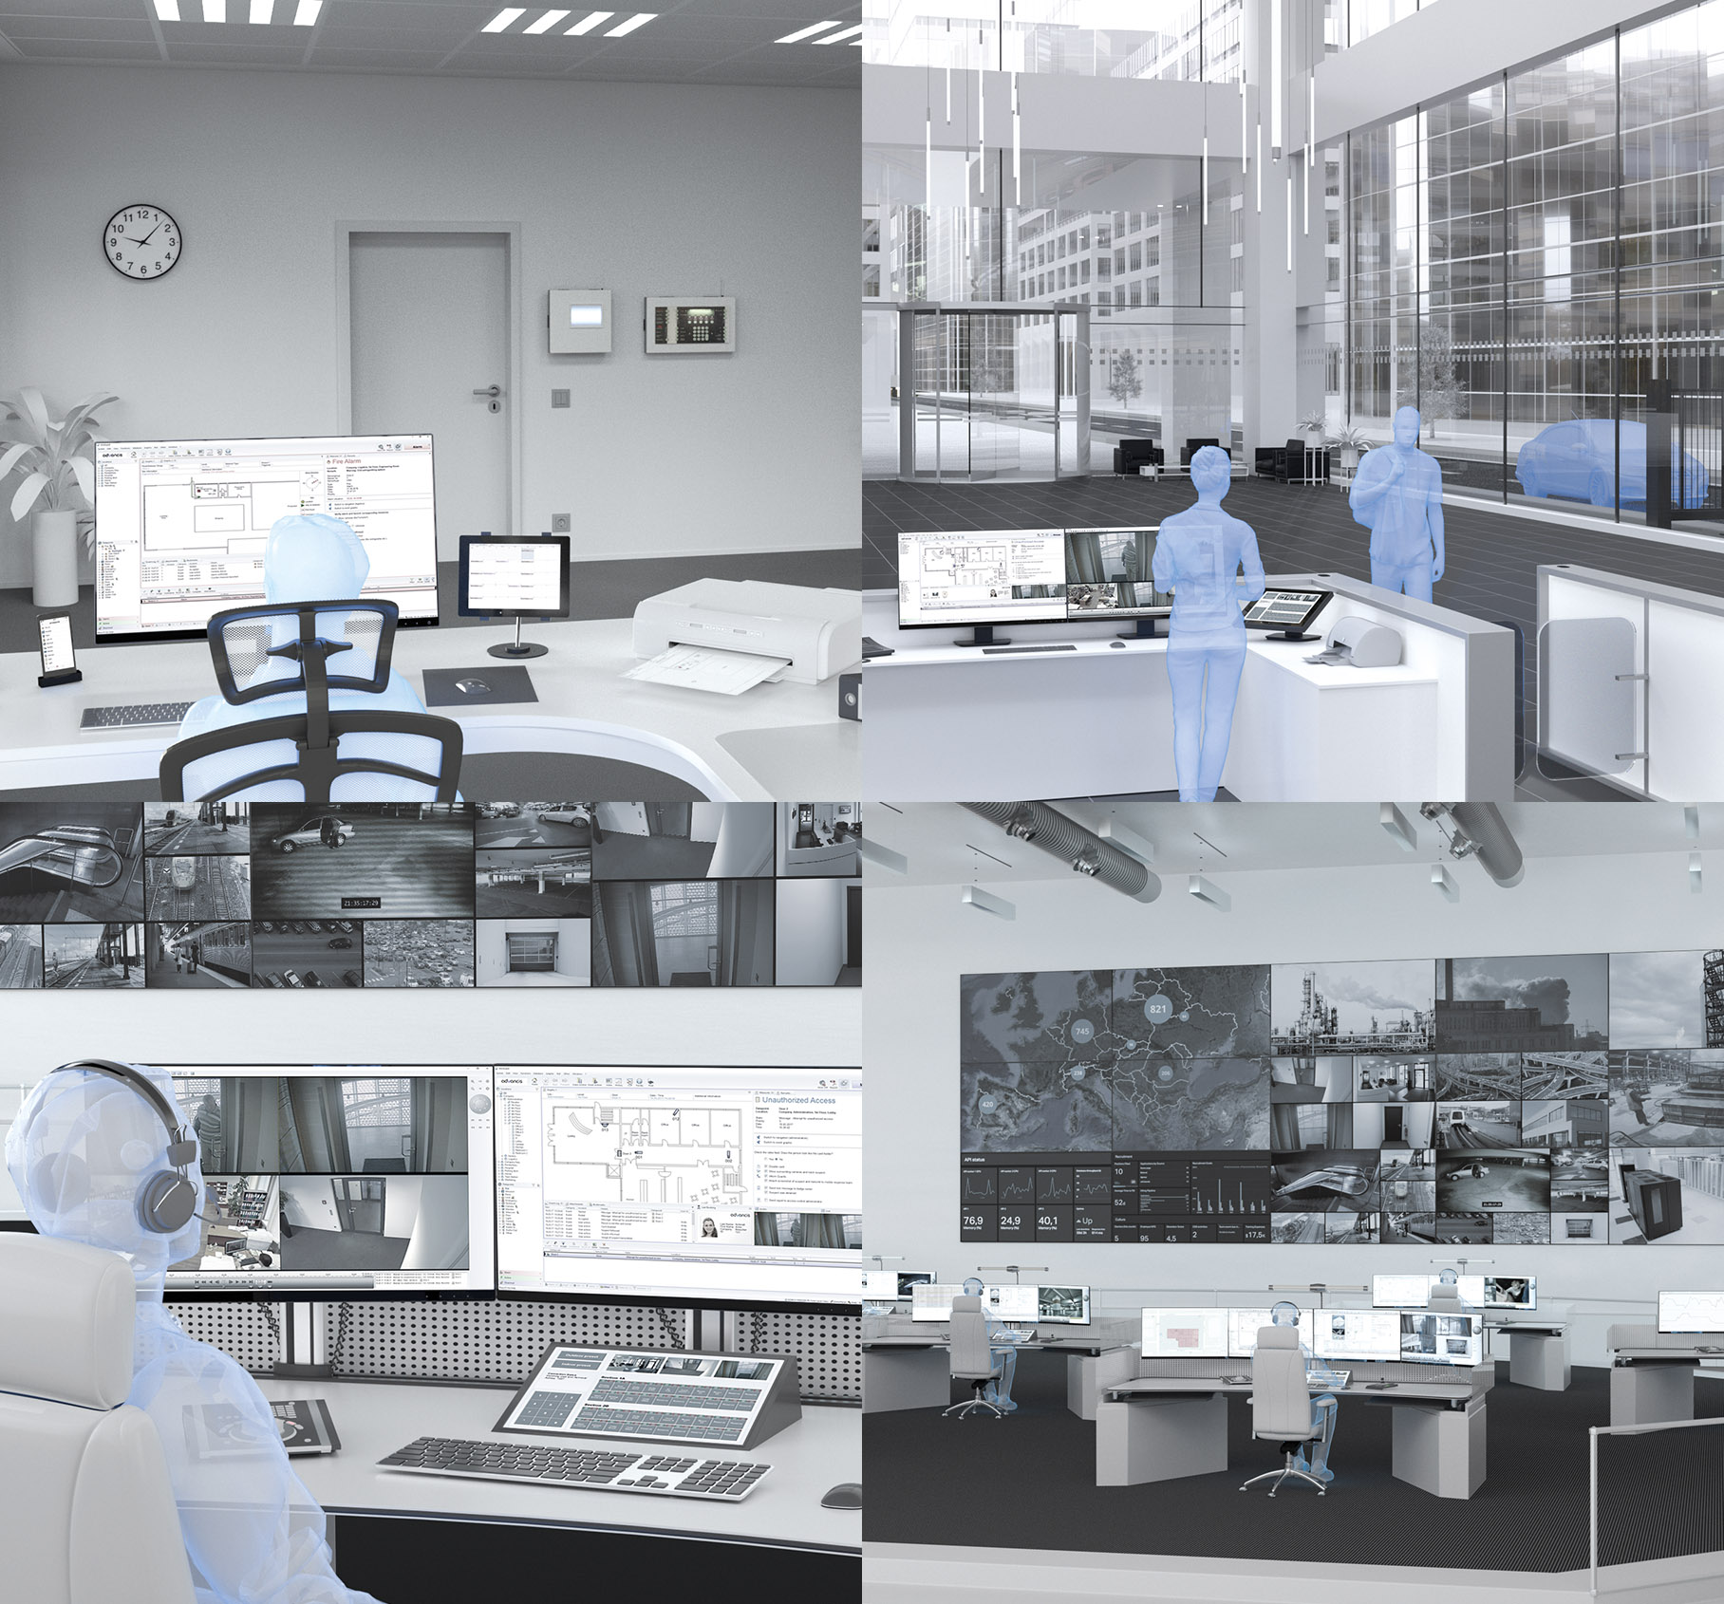
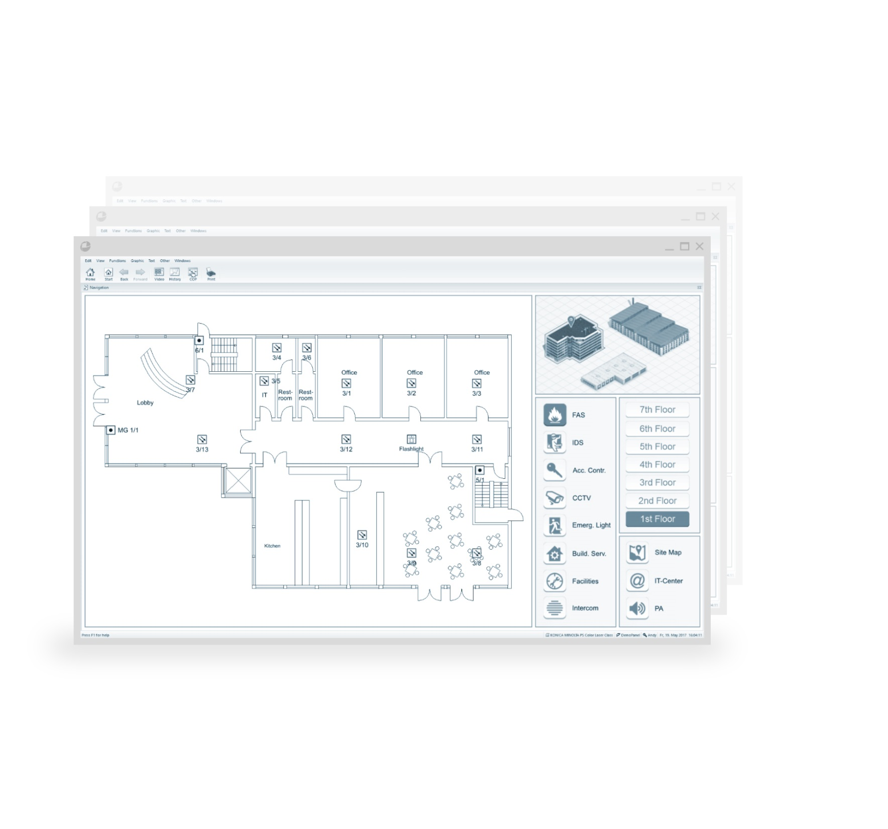
Vendor-neutral Management System
More than 450 Interfaces
Uniform User Interface
Guided Workflows
Reports and Evaluations
Security and Reliability
Investment Protection due to Scalability

Slide 17
Our suppliers

Slide 18
Our systems are certified according to all relevant international and domestic standards
Certificates
Licenses
References

Slide 19
We have all necessery local licences
Ministry of internal affairs of Serbia – licenses for security systems
Ministry of internal affairs of Serbia – licenses for fire protection systems
Certificates
Licenses
References
Serbian Chamber of Engineers – licenses for personel

Slide 20
Reference list excerpt from our consortium:
Public Enterprise Electric Power Industry of Serbia (JP EPS)
NIS Oil industry of Serbia
Radio Television of Serbia, Belgrade
National Museum Belgrade
MFC “Ušće” Belgrade,
Building „Old Mill“ Belgrade,
Arms industry „Milan Blagojevic“, „Sloboda Čačak“, „Krušik“,
Port Novi Sad, Port Sremska Mitrovica, Port Bogojevo,
Thermal power plant Kostolac,
Hydroelectric power plants Djerdap,
Cargo port in thermal power plant „Nikola Tesla B“,
Wastewater treatment plant Boljevac, Mokrin,
Gerontology Centre Belgrade,
Health Company „PharmaSwiss“,
Hall „Aleksandar Nikolić“ – Pionir,
Electrical substations „Belgrade 6“, „Nis 6“, „Smederevo“,
Wind turbines „Krivaca“, „Kosava“, „Alibunar“, „Kula“.
Thermo powerplants Nikola Tesla
Thermo powerplants Kostolac
Belgrade Waterfront, BW Metropolitan
Certificates
Licenses
References

Slide 21
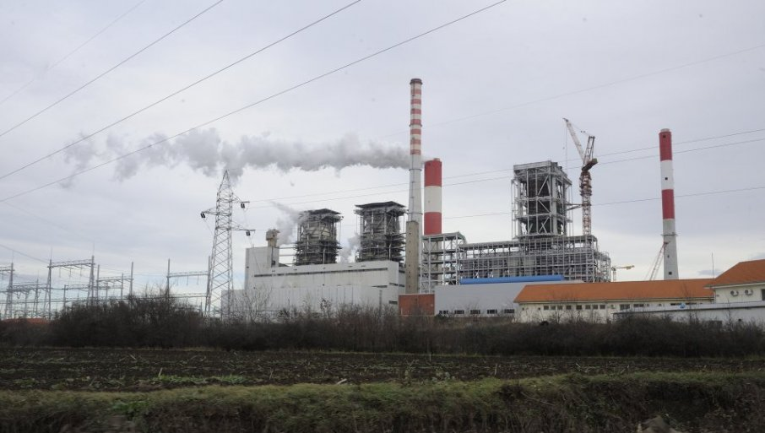
Thermo powerplant Kostolac B3
Video surveillance system
Telecommunication network
Video wall
˃ 500 cameras, multi site video management solution, explosion-proof subsystem

Slide 22
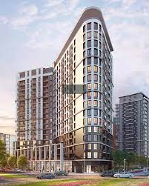
BW Metropolitan
Fire detection system
Gas CO detection system
Video surveillance system
Video intercom system
Computer network
Public address system
328 apartments, 22.000 m², 20 floors, 7 commercial spaces

